Slide 1
Mentor Demo
Norbert Szücs
Pallida Cohort - Static Class

Slide 2

Before Green Fox Academy
Notes:
Many of us arrived here without any knowledge of programming. We wanted to learn and of course still want to. I felt myself like a baby who knows nothing.

Slide 3
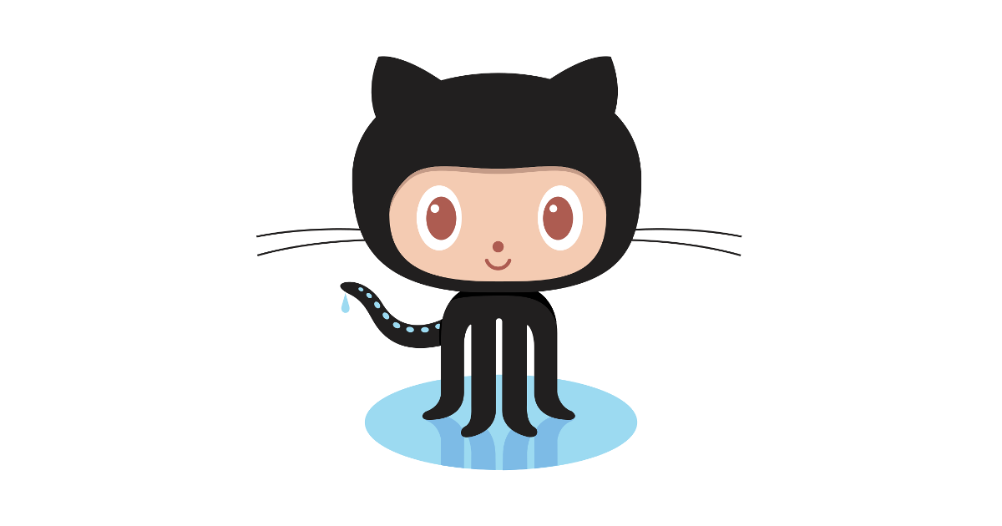
Early stage
Notes:
Remember this, yeah? This cute octocat is very adorable. Do you remember the suffering it caused aswell? This was the first challenge for me. But we absorbed it quite quickly, now we all have every pieces of important information in our githun.

Slide 4
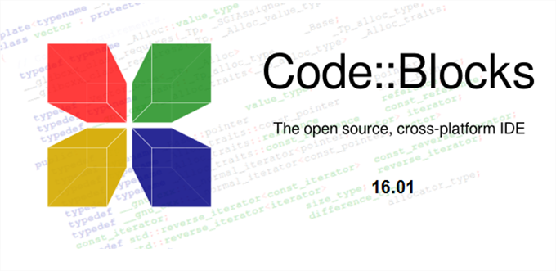
Early stage
Notes:
Introduction to CodeBlocks, along with C programming language where we learned the basics, what is a vaiable, data types, basic math operators, if statement, if else statement and so on. It was though and tiring.
Then we continued our way into the loops where we successfully accomplished the tasks like anagram, palindrome builder and searcher, and, my personal favourite, the josephus problem.

Slide 5
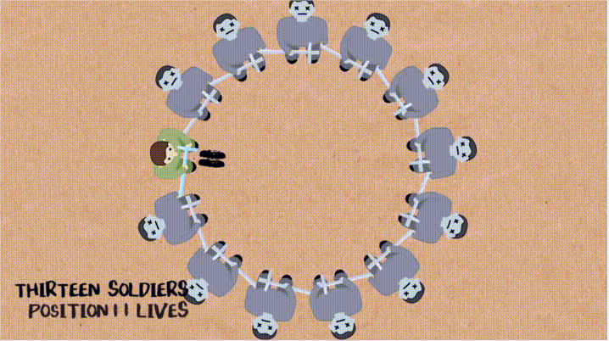
Early stage
Notes:
Here we had to solve the problem of staying alive, deciding where to stand if everyone kills the person next to each other.

Slide 6
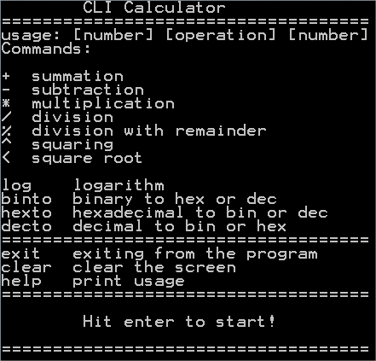
Early stage++
Notes:
Then we arrived to our first project, in the early stage++, which was the CLI calculator. It can do some basic math operations, like sum, subtract and also some advanced ones, like log, binary to hex. We needed to use all the knowledge we have gathered until this project.

Slide 7
Early stage++
Pointers
Structs
Todo-app
Unions
Typedef
Notes:
We have arrived to our next level of challenge. Pointers, Structs, unions and all kind of things. The result was our second big project, the Todo-app

Slide 8
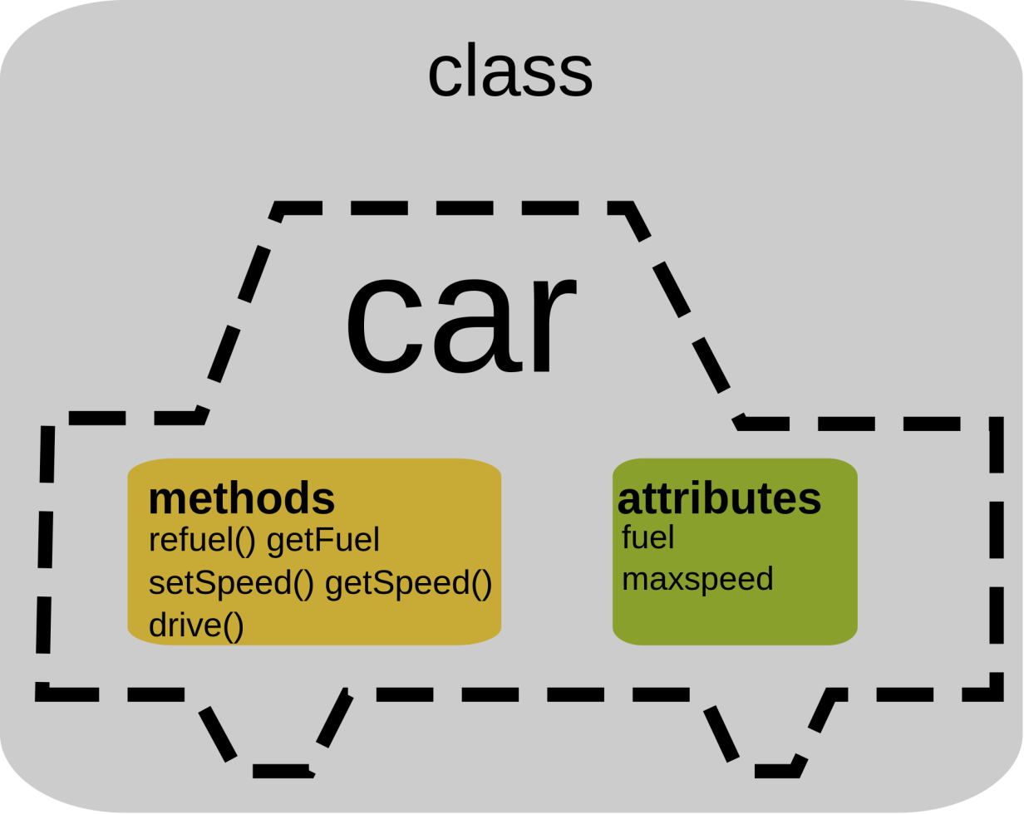
Orientation Stage
Notes:
3 weeks ago we started our carrier in object oriented programming, with the help of C++ where are started our new language.

Slide 9
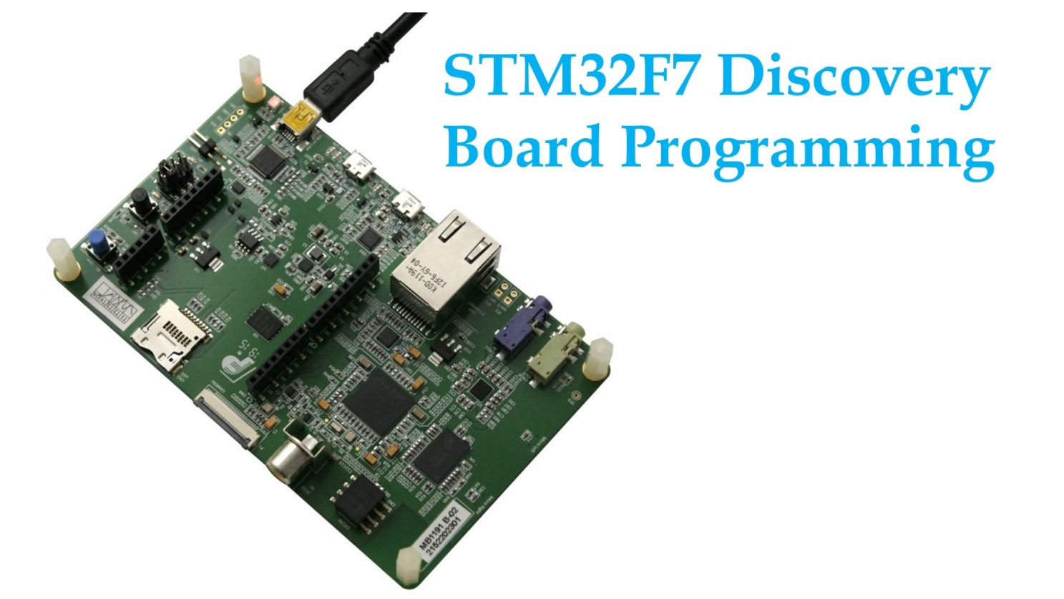
Orientation Stage++
Notes:
And finally we have arrived to our actual studies, what we wer all excited about, the real hardware programming, where we could release our creativity, do things with leds and buttons and so on.
My message today is the following. We had many ups and downs, long nights spent in front of the computer watching Mr. Bucky and some guys from India. It was quite challenging for everyone I believe but note this. All the sacrefices we made, all the hours we spent with learning, we couldn’t have this knowledge. 8 weeks have passed. Only 2 months. Most people usually just sniff into a profession during this timeframe. And now we know a lot. We can do programming, solve a lot of cases. Be proud of yourself!

Slide 10
Thank you for your attention!

